Slide 1


Quantum Cognition and Bounded Rationality
Symposium on logic, music and quantum information
Florence, June 15-17, 2013
Reinhard Blutner
Universiteit van Amsterdam

Slide 2
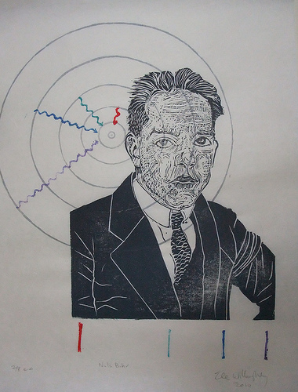
Bohr´s (1913) Atomic Model
Almost exact results for systems where two charged points orbit each other (→ spectrum of hydrogen)
Cannot explain the spectra of larger atoms, the fine structure of spectra, the Zeeman effect.
Conceptual problems: conservation laws (energy, momentum) do not hold, it violates the Heisenberg uncertainty principle.
Notes:
Ferris Wheel Illusion. If you do not see it, you should see a doctor.

Slide 3
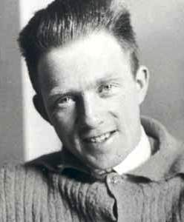
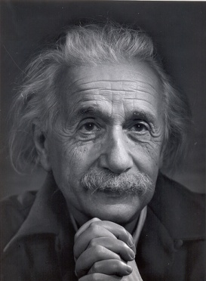
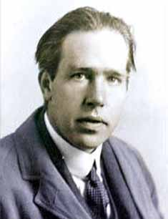
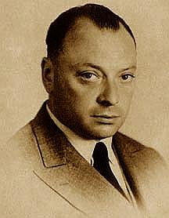
Quantum Mechanics
Heisenberg
Einstein
Bohr
Pauli
Historically, QM is the result of an successful resolutions of the empirical and conceptual problems in the development of atomic physics (≈1900-1925)
The founders of QM have borrowed some crucial ideas from psychology
Notes:
Ferris Wheel Illusion. If you do not see it, you should see a doctor.

Slide 4
Complementarity
William James was the first who introduced the idea of complementarity into psychology
“It must be admitted, therefore, that in certain persons, at least, the total possible consciousness may be split into parts which coexist but mutually ignore each other, and share the objects of knowledge between them. More remarkable still, they are complementary” (James, the principles of psychology 1890, p. 206)
Nils Bohr introduced it into physics (Complementarity of momentum and place) and proposed to apply it beyond physics to human knowledge.
4
Notes:
4

Slide 5
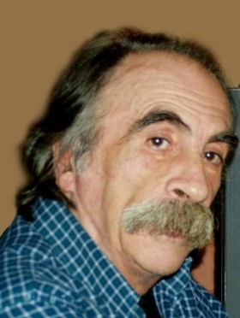
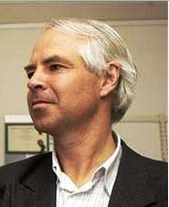
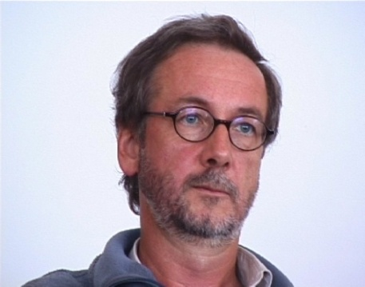
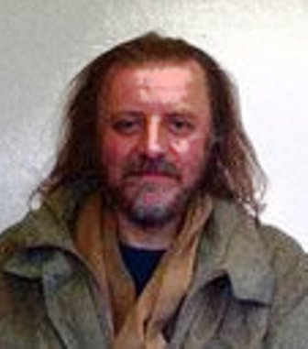
Quantum Cognition
Conte
1989
Khrennikov
1998
Atmanspacher
1994
Heisenberg
Einstein
Bohr
Pauli
Aerts 1994
Historically, Quantum Cognition is the result of an successful resolutions of the empirical and conceptual problems in the development of cognitive psychology
Basically, it resolves several puzzles in the context of “bounded rationality”
Notes:
Ferris Wheel Illusion. If you do not see it, you should see a doctor.

Slide 6
Some recent publications
Bruza, Peter, Busemeyer, Jerome & Liane Gabora. Journal of Mathe-matical Psychology, Vol 53 (2009): Special issue on quantum cognition
Busemeyer, Jerome & Peter D. Bruza (2012): Quantum Cognition and Decision Cambridge, UK Cambridge University Press.
Pothos, Emmanuel M. & Jerome R. Busemeyer (2013): Can quantum probability provide a new direction for cognitive modeling? Behavioral & Brain Sciences 36, 255–327.
http://en.wikipedia.org/wiki/quantum_cognition
http://www.quantum-cognition.de/
One key challenge is to anticipate new findings rather than simply accommodate existing data
Looking for new domains of application
6
Notes:
6

Slide 7
Outline
Phenomenological Motivation: Language and cognition in the context of ‘bounded rationality’
Logical Motivation: The conceptual necessity of quantum models of cognition
Some pilot applications
Two qubits for C. G. Jung’s theory of personality
One qubit for Schoenberg’s modulation theory
7
Notes:
7

Slide 8
I Phenomenological Motivation
8
Notes:
8

Slide 9
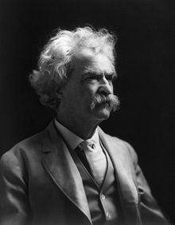
Historic Recurrence
"History does not repeat itself, but it does rhyme" (Mark Twain)
The structural similarities between the quantum physics and the cognitive realm are a consequence of the dynamic and geometric conception that underlies both fields (projections)
"Hence we conclude the propositional calculus of quantum mechanics has the same structure as an abstract projective geometry" (Birkhoff & von Neumann 1936)
What is the real motivation of this geometric conception?

Slide 10
Bounded rationality (Herbert Simon 1955)
Leibniz dreamed to reduce rational thinking to one universal logical language: the characteristica universalis.
Rational decisions by humans and animals in the real world are bound by limited time, knowledge, and cognitive capacities. These dimensions are lacking classical models of logic and decision making.
Some people such as Gigerenzer see Leibniz’ vision as a unrealistic dream that has to be replaced by a toolbox full of heuristic devices (lacking the beauty of Leibniz’ ideas)
Notes:
Wikipedia bounded rationality, satisficing
10

Slide 11
Puzzles of Bounded Rationality
Order effects: In sequences of questions or propositions the order matters: (A ; B) ≠ (B ; A) (see survey research)
Disjunction fallacy: Illustrating that Savage’s sure-thing principle can be violated
Graded membership in Categorization: The degree of membership of complex concepts such as in “a tent is building & dwelling” does not follow classical rules (Kolmogorov probabilities)
Others: Conjunction puzzle (Linda-example), Ellsberg paradox, Allais paradox, prisoner dilemma, framing, …
11
Notes:
11

Slide 12
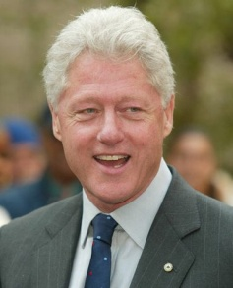
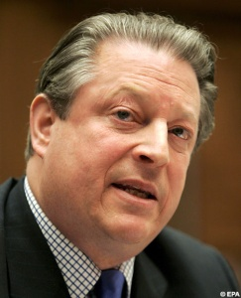
Order Effects
Is Clinton honest? 50% Is Gore honest? 68%
Assimilation
Is Gore honest? 60% Is Clinton honest? 57%
Moore (2002)
Busemeyer and Wang (2009)

Slide 13
Disjunction puzzle
Tversky and Shafir (1992) show that significantly more students report they would purchase a nonrefundable Hawaiian vacation if they were to know that they have passed or failed an important exam than report they would purchase if they were not to know the outcome of the exam
Prob(A|C) = 0.54
Prob(A|¬C) = 0.57
Prob(A) = 0.32
Prob(A) = Prob(A|C) Prob(C) + Prob(A|¬C) Prob(¬C) since (C∩A)∪(¬C∩A) = A (distributivity)
The ‘sure thing principle’ is violated empirically!
Notes:
13
13

Slide 14
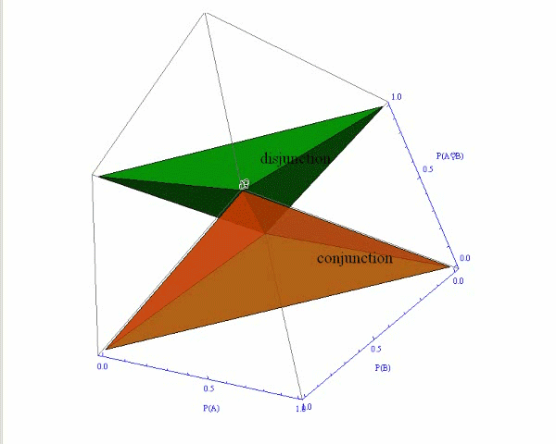
Pitkowsky diamond
Conjunction
Prob(A∩B) ≤ min(Prob(A),P(B))
Prob(A)+Prob(B)−Prob(A∩B) ≤ 1
Disjunction
Prob(A∪B) ≥ max(Prob(A),Prob(B))
Prob(A)+Prob(B)−Prob(A∪B) ≤ 1
Notes:
14

Slide 15
Hampton 1988: judgement of membership
A and B
overextension
A or B
underextension, *additive
A | B
Furniture Food Weapon Building Machine Bird | Household appliances Plant Tool Dwelling Vehicle Pet
A | B
Home furnishing Hobbies Spices Instruments Pets Sportswear Fruits Household appliances | Furniture Games Herbs Tools Farmyard animals Sports equipment Vegetables Kitchen utensils
Notes:
15

Slide 16
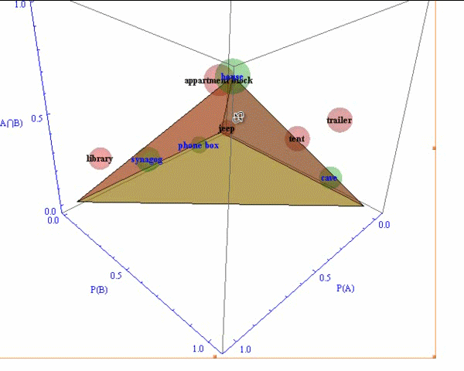
Conjunction (building & dwelling)
Classical: cave, house, synagogue, phone box.
Non-classical: tent, library, apartment block, jeep, trailer.
Example ‘overextension’
Prob_{library}(building) = .95
Prob_{library}(dwelling) = .17
Prob_{library}(build & dwelling) = .31
Cf. Aerts 2009
Notes:
16

Slide 17
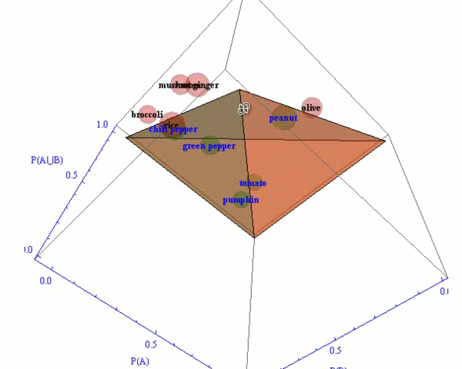
Disjunction (fruit or vegetable)
Classical: green pepper, chili pepper, peanut, tomato, pumpkin.
Non-classical: olive, rice, root ginger mushroom, broccoli,
Example ‘additivity’
Prob_{olive}(fruit) = .5
Prob_{olive}(vegetable) = .1
Prob_{olive}(fruit ∪ vegetable) = .8
Cf. Aerts 2009
Notes:
17

Slide 18
II Logical Motivation
18
Notes:
18

Slide 19

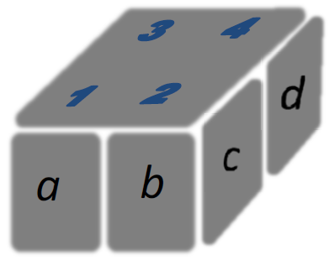
Bounded Rationality and Foulis‘ firefly box
W = {1,2,3,4,5}. World 5 indicates no lighting.
a b n
F = {{1,3}, {2,4}, {5}}
c d n
S = {{1,2}, {3,4}, {5}}
a.c b.c a.d b.d n
T = {{1},{2}, {3},{4}, {5}}
(Foulis' lattice of attributes)

Slide 20
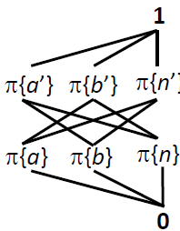
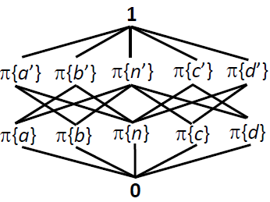
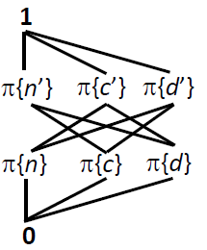
Orthomodular Lattices
The union of the two Boolean perspectives F and S gives an orthomodular lattice
The resulting lattice it non-Boolean. It violates distributivity: π{a}∪(π{a’}∩π{d’}) = π{a}∪π{n} = π{b’} However, distributivity would result in 1.

Slide 21
Piron’s Representation Theorem
All orthomodular lattices which satisfy the conditions of atomicity, coverability, and irreducibility can be represented by the lattice of actual projection operators of a so-called generalized Hilbert space (with some additional condition the result is valid for standard Hilbert spaces; cf. Solér, 1995)
In case of the firefly box all conditions are satisfied.
The firefly box
Orthomodular Lattice
x ’’ = x
if x ≤ y then y ’ ≤ x ’
x ∧ x ’ = 0
if x ≤ y then y = x ∨ (x ’∧y) (orthomodular law)
π(a)
π(d)
α
π(c)
π(b)

Slide 22



Gleason’s Theorem
Measure functions:
Prob(A+B) = Prob(A)+Prob(B) for orthogonal subspaces A, B
The following function is a measure function: Prob(A) = |P_{A} (s)|² for any vector s of the Hilbert space
Each measure functions can be expressed as the convex hull of such functions (Gleason, 1957)
s
A
u

Slide 23
(Local) Realism and the firefly
s
Observing side window: Prob(c ) ≈ 1, Prob(d ) ≈ 0
Observing front window: Prob(a) ≈ ½ , Prob(b) ≈ ½
Observing side window again: Prob(c ) ≈ ½, Prob(d ) ≈ ½
The firefly box
π(a)
π(c)
π(d)
π(b)
Object attributes have values independent of observation
This condition of realism is satisfied in the macro-world (corresponding to folk physics; ontic perspective, hidden variables)
It is violated for tiny particles and for mental entities.

Slide 24
Bounded rationality → quantum cognition
The existence of incompatible perspectives is highly probable for many cognitive domains (beim Graben & Atmanspacher 2009)
Orthomodular lattices can arise from capacity restrictions based on partial Boolean algebras. Adding the insight of Gleason‘s theorem necessitates quantum probabilities as appropriate measure functions
Adding ideas of dynamic semantics (Baltag & Smets 2005), completes the general picture of quantum cognition as an exemplary action model.
Reinhard Blutner
24
Notes:
24

Slide 25
Order-dependence of projections
The probability of a sequence ‘B and then A ’ measured in the initial state s comes out as (generalizing Lüders’ rule) Prob_{s} (B ; A) = |P_{A} P_{B} s |²
|P_{A} P_{B} s |² ≠ |P_{B} P_{A} s |²
‘B and then A ’ and ‘A and then B ’ are equally probable only if A and B commute.
a
s
b
P_{A} P_{B} s
P_{B} P_{A} s
Reinhard Blutner
25
Notes:
25

Slide 26
Asymmetric conjunction
The sequence of projections ‘B and then A ’, written (P_{B} ;P_{A}) corresponds to an operation of ‘asymmetric conjunction’
|P_{A} P_{B} s |² = ⟨P_{A} P_{B} s |P_{A} P_{B}s ⟩ = ⟨s |P_{B}P_{A}P_{B}s ⟩ P_{B} P_{A} P_{B} is a Hermitian operator and can be identified as the operator of asymmetric conjunction: (P_{B} ; P_{A}) = P_{B} P_{A} P_{B}
Basically, it is this operation that explains
Order effects
The disjunction puzzle
Hampton’s membership data
and other puzzles of bounded rationality
Reinhard Blutner
26
Notes:
26

Slide 27
Conditioned Probabilities
Prob(A|C) = Prob(CA)/Prob(C) (Classical)
Prob(A|C) = Prob(CAC)/Prob(C) (Quantum Case, cf. Gerd Niestegge, generalizing Lüders’ rule)
If the operators commute, Niestegge’s definition reduces to classical probabilities: CAC = CCA = CA
Interferences
A = C A + C⊥ A (classical, no interference)
A = CAC + C⊥AC⊥ + CAC⊥ + C ⊥AC (interference terms)
Reinhard Blutner
27
Notes:
27
27

Slide 28
Interference Effects
Classical:
Prob(A) = Prob(A|C) Prob(C) + Prob(A|¬C) Prob(¬C)
Quantum:
Prob(A) = Prob(A|C) Prob(C) + Prob(A|C⊥) Prob(C⊥) + ∂(C, A),
where ∂(C, A) = Prob(CAC⊥ + C ⊥AC) [Interference Term]
Proof
Since C+C⊥= 1, C⊥C = CC⊥ = 0, we get
A = CAC + C⊥AC⊥ + CAC⊥ + C ⊥AC
Reinhard Blutner
28
Notes:
28
28

Slide 29
Calculating the interference term
In the simplest case (when the propositions C and A correspond to projections of pure states) the interference term is easy to calculate:
∂(C, A) = Prob(CAC⊥ + C⊥AC)
= 2 Prob^{½} (C; A) Prob^{½} (C⊥; A) cos Δ
The interference term introduces one free parameter: The phase shift Δ.
Reinhard Blutner
29
Notes:
29
29

Slide 30
Solving the Tversky/Shafir puzzle
Tversky and Shafir (1992) show that significantly more students report they would purchase a nonrefundable Hawaiian vacation if they were to know that they have passed or failed an important exam than report they would purchase if they were not to know the outcome of the exam.
Prob(A|C) = 0.54
Prob(A|C⊥) = 0 .57
Prob(A) = 0 .32
∂(C, A) = [Prob(A|C) Prob(C) + Prob(A|C⊥) Prob(C⊥)] − μ(A) = 0.23
→ cos Δ = -0.43; Δ = 2.01 ≈ 231°
Reinhard Blutner
30
Notes:
30
30

Slide 31
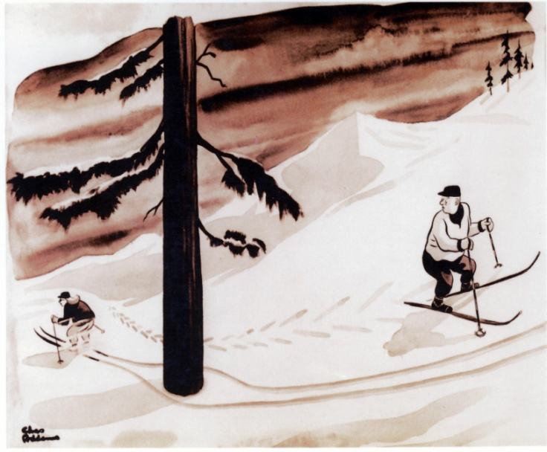
Conclusions: The (virtual) conceptual necessity of quantum probabilities
The general idea of geometric models of meaning in the spirit of QT and the whole idea of quantum probabilities is a consequence of Piron’s representation theorem and Gleason’s theorem.
The firefly examples illustrates how orthomodular lattices can arise from capacity restrictions. Hence, orthomodular lattices (but not Boolean lattices) are conceptually plausible from a general psychological perspective.
Since the ‘mind’ is not an extended thing locality cannot be a mode of the mind. Hence, the quantum paradoxes (e.g. EPR – non-locality) do not appear within the cognitive realm.
Notes:
31
31

Slide 32
III Some pilot applications
32
Notes:
32

Slide 33
Qubit states
A bit is the basic unit of information in classical computation referring to a choice between two discrete states, say {0, 1}.
A qubit is the basic of information in quantum computing referring to a choice between the unit-vectors in a two-dimensional Hilbert space.
For instance, the orthogonal states and can be taken to represent true and false, the vectors in between are appropriate for modeling vagueness.
Notes:
33

Slide 34
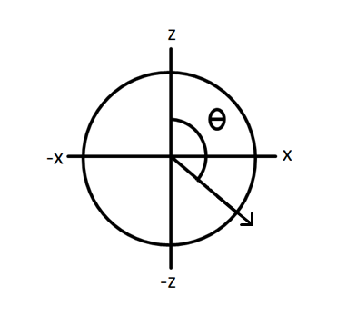
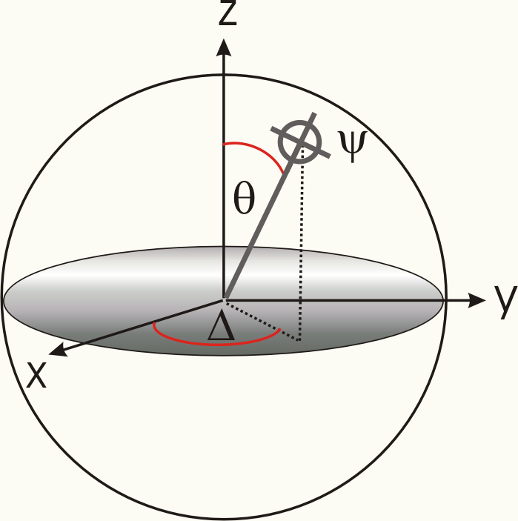
Bloch spheres
Real Hilbert Space:
Complex Hilbert Space
ψ

Slide 35
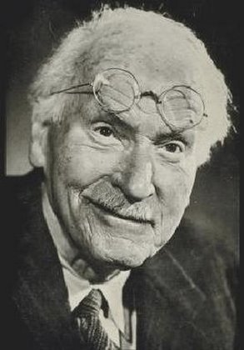
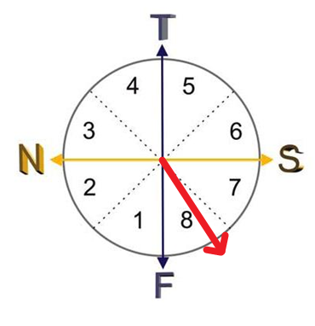
C.G. Jung’s theory of personality
3 dimensions
Introverted vs. Extraverted
Thinking vs. Feeling
Sensation vs. iNtuition
8 basic types

Slide 36

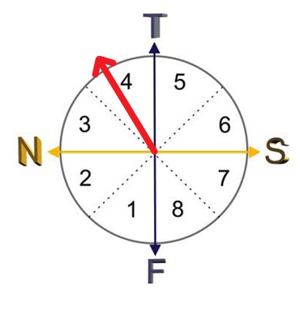

Sherlock Holmes
Introverted iNtuitive Thinker
Shadow
Extraverted Sensing Feeler

Slide 37
Diagnostic Questions
When the phone rings, do you hasten to get to it first, or do you hope someone else will answer? (E/I)
In order to follow other people do you need reason, or do you need trust? (T/F)
c. Are you more attracted to sensible people or imaginative people? (S/N)

Slide 38
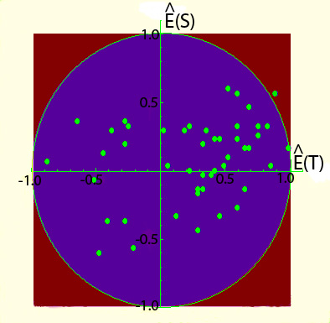
Predictions of the model
Real Hilbert space:
Complex Hilbert space

Slide 39
Computational Music Theory
Bayesian approaches
e.g. David Templey, Music and Probability (MIT Press 2007).
Music perception is largely probabilistic in nature
Where do the probabilities come from?
Structural approaches
E.g. Guerino Mazzola, The Topos of Music (Birkhauser 2002).
Music perception (esp. perception of consonances/dissonances) based on certain symmetries
Purely structuralist approach without probabilistic elements
Quantum theory allows for structural probabilities (derived from pure states and projectors)

Slide 40
Fux's classification of consonance and dissonance
octave | fifth | fourth | major 3rd | minor 3rd | minor 6th | major 2nd | tri- tone | major 6th | minor 7th | major 7th | minor 2nd
concords |  |  |  |  |  |  |  |  | discords
2/1 | 3/2 | 4/3 | 5/4 | 6/5 | 8/5 | 9/8 | 11/8 | 13/8 | 14/8 | 15/8 | 12/11
Mazzolas approach explains the classical Fuxian consonance/dissonance dichotomy (simulating Arnold Schoenberg’s modulation theory)
It should be combined with a probabilistic approach

Slide 41
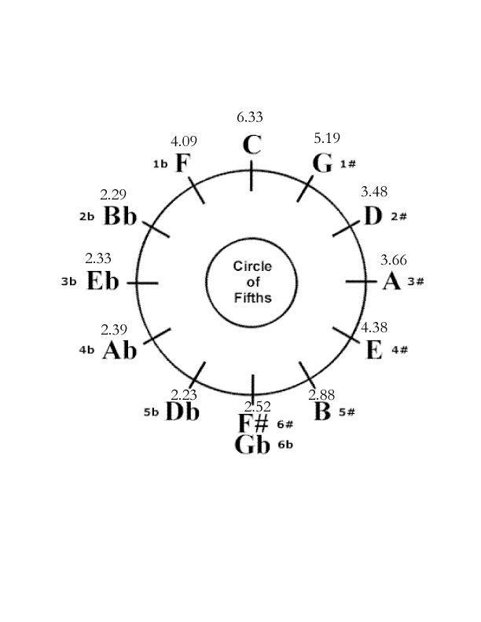
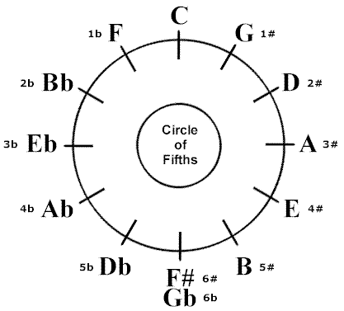

The circle of fifths
z
x
Krumhansl & Kessler 1982: How well does a pitch fit a given key? (scale from 1-7)

Slide 42
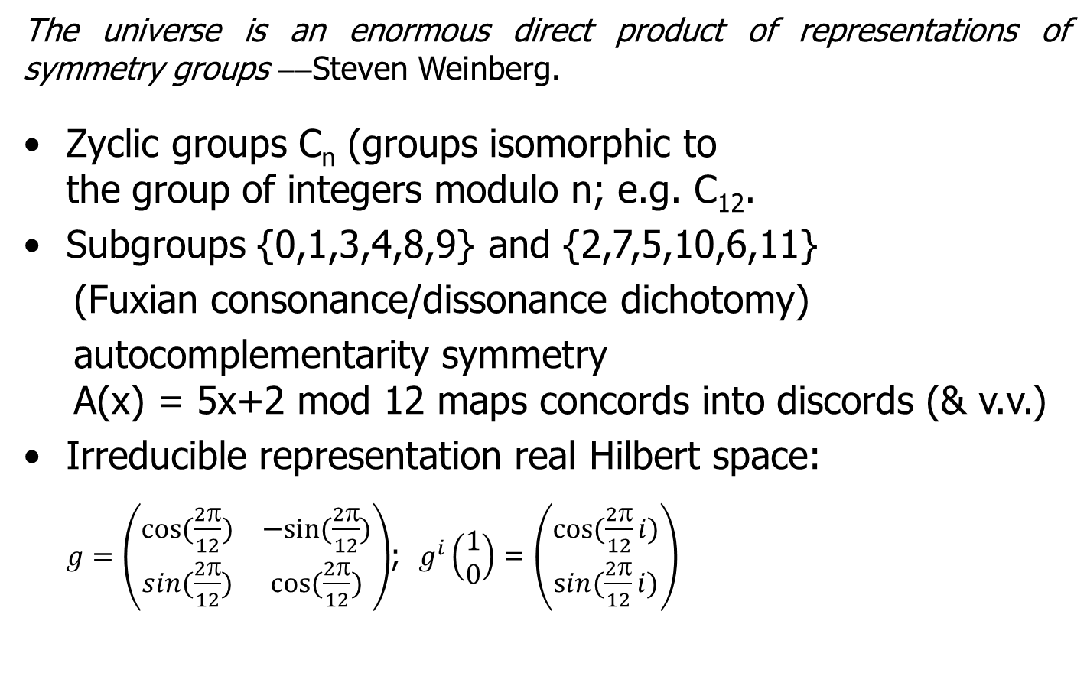
Mathematical Motivation
The universe is an enormous direct product of representations of symmetry groups −−Steven Weinberg.
Zyclic groups C_{n} (groups isomorphic to the group of integers modulo n; e.g. C₁₂.
Subgroups {0,1,3,4,8,9} and {2,7,5,10,6,11}
(Fuxian consonance/dissonance dichotomy)
autocomplementarity symmetry A(x) = 5x+2 mod 12 maps concords into discords (& v.v.)
Irreducible representation real Hilbert space: $g=\left(\begin{matrix}cos⁡(\frac{2π}{12}) & −sin⁡(\frac{2π}{12}) \\ sin⁡(\frac{2π}{12}) & cos⁡(\frac{2π}{12})\end{matrix}\right)$; $g^{i}\left(\begin{matrix}1 \\ 0\end{matrix}\right)$ = $\left(\begin{matrix}cos⁡(\frac{2π}{12}i) \\ sin⁡(\frac{2π}{12}i)\end{matrix}\right)$
C₁₂

Slide 43

Major keys
C | G | D | A | E | B | F♯ | C♯ | A♭ | E♭ | B♭ | F
Minor keys
Krumhansl & Kessler 1982
Kostka & Payne 1995
C | G | D | A | E | B | F♯ | C♯ | A♭ | E♭ | B♭ | F

Slide 44

?
?
?
?
?
?
?
?
?
?
?
?
?
?
?
?
?
?
?
?
?
?
?
?
?
?
?
?
?
?
?
?
?
?
?
?
0
2
4
6
8
10
12
0.2
0.4
0.6
0.8
Major/minor keys
?
?
?
?
?
?
?
?
?
?
?
?
?
?
?
?
?
?
?
?
?
?
?
?
?
?
?
?
?
?
?
?
?
0
2
4
6
8
10
12
0.2
0.4
0.6
0.8
C | G | D | A | E | B | F♯ | C♯ | A♭ | E♭ | B♭ | F
Reinhard Blutner

Slide 45

Tonica/Scale
?
?
?
?
?
?
?
?
?
?
?
?
?
?
?
?
?
?
?
?
?
?
?
?
?
?
?
?
0
2
4
6
8
10
12
0.2
0.4
0.6
C | G | D | A | E | B | F♯ | C♯ | A♭ | E♭ | B♭ | F

Slide 46



Complementary Pitches
C | G | D | A | E | B | F♯ | C♯ | A♭ | E♭ | B♭ | F

Slide 47
Conclusions
Quantum probabilities are motivated by taking capacity limitations as a structural factor motivating an orthomodular lattice.
Some effects of interference, non-commutativity, and entanglement have been found.
In quantum theory there are two sources for probabilities
Uncertainty about the state of the system → likewise found in classical systems
the mathematical structure of the event system (complementarity) → leading to structural (geometric) probabilities
The explanatory value of quantum models is based on these structural probabilities. Anticipating new findings rather than simply accommodating existing data.
Notes:
47
47

Slide 48
Abstract
Quantum mechanics is the result of a successful resolution of stringent empirical and profound conceptual conflicts within the development of atomic physics at the beginning of the last century. At first glance, it seems to be bizarre and even ridiculous to apply ideas of quantum physics in order to improve current psychological and linguistic/semantic ideas. However, a closer look shows that there are some parallels in developing quantum physics and advanced theories of cognitive science dealing with concepts and conceptual composition. Even when history does not repeat itself, it does rhyme.
In both cases of the historical development the underlying basic ideas are of a geometrical nature. In psychology, geometric models of meaning have a long tradition. However, they suffer from many shortcomings: no clear distinction between vagueness and typicality, no clear definition of basic semantic objects such as properties and propositions, they cannot handle the composition of meanings, etc. My main suggestion is that geometric models of meaning can be improved by borrowing basic concepts from (von Neumann) quantum theory. In this connection, I will show that quantum probabilities are of (virtual) conceptual necessity if grounded in an abstract algebraic framework of orthomodular lattices motivated by combining Boolean algebras by taking certain capacity restrictions into account. If we replace Boolean algebras (underlying classical probabilities) by orthomodular lattices, then the corresponding measure function is a quantum probability measure. I will demonstrate how several empirical puzzles discussed in the framework of bounded rationality can be resolved by quantum models. Further, I will illustrate how a simple qubit model of quantum probabilities can be applied to music, in particular to key perception. I will illustrate how the relevant key profiles for major and minor keys (Krumhansl & Kessler 1982) can be approximated in the qubit model.

